Slide 1
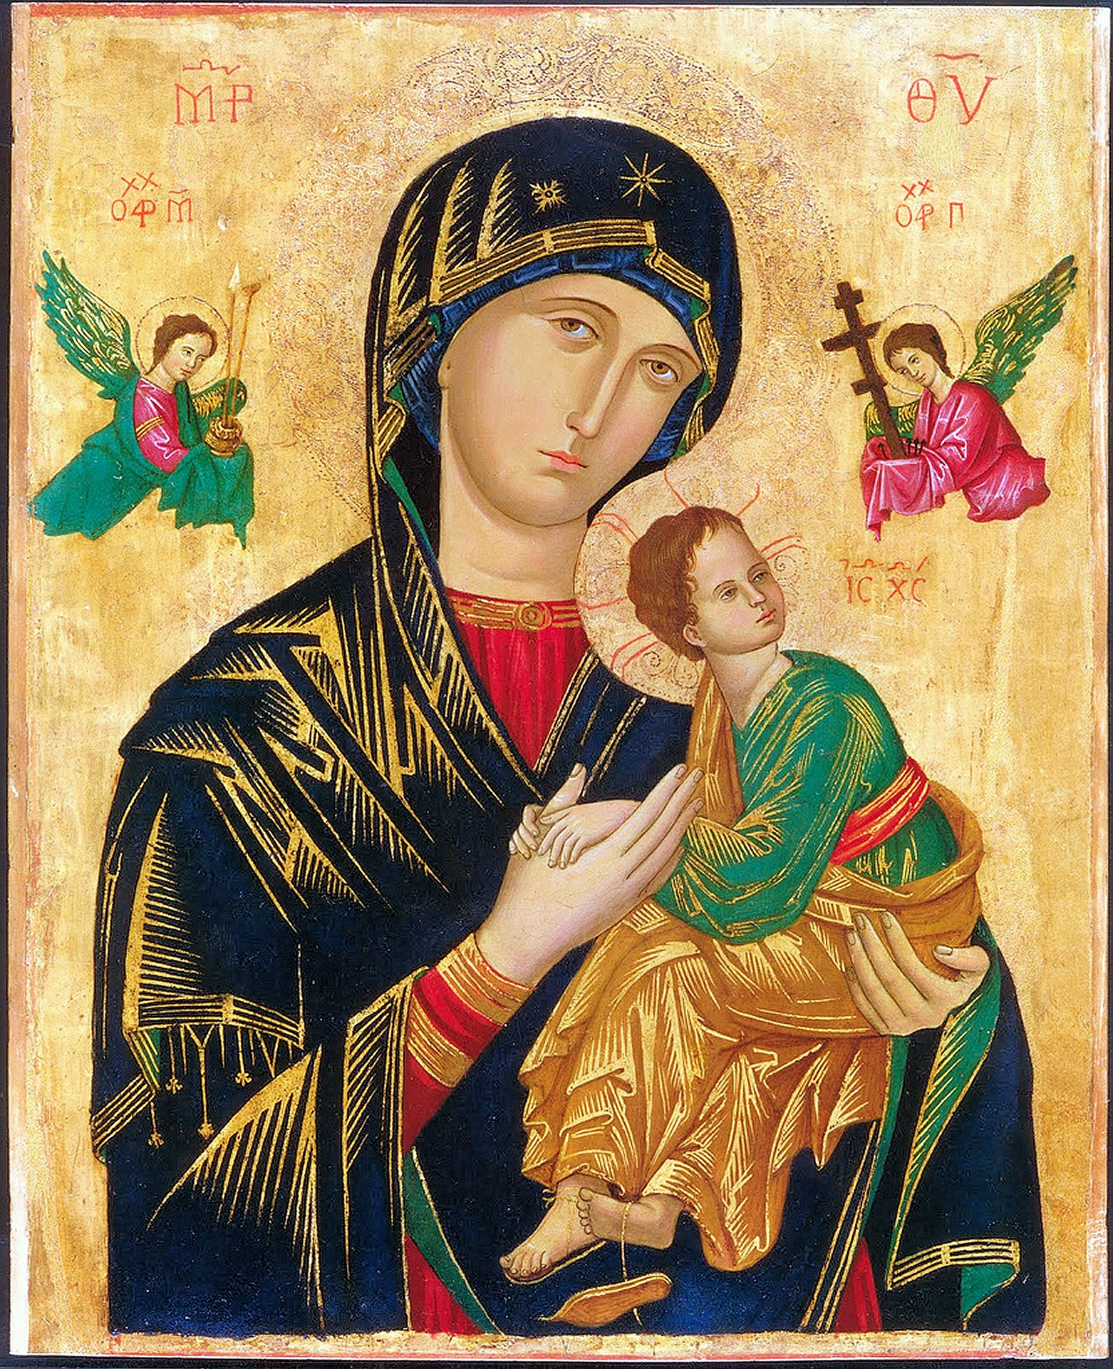


HOME
ABOUT
DESIGND BY MUYUESHOP
Exquisite Old Times
精致的旧时光
I walked through many mountains, walked through many waters, and knew many people. The only thing that really makes me tempted is that you see me at the moment. But there is not too much extravagant hope, but I hope to have your heart, not to leave.
COLLECTION

Slide 2


HOME
ABOUT
DESIGND BY MUYUESHOP
TEMPALTE DESIGEND
I walked through many mountains, walked through many waters, and knew many people. The only thing that really makes me tempted is that you see me at the moment. But there is not too much extravagant hope, but I hope to have your heart, not to leave.
I walked through many mountains, walked through many waters, and knew many people. The only thing that really makes me tempted is that you see me at the moment. But there is not too much extravagant hope, but I hope to have your heart, not to leave.
COLLECTION

Slide 3



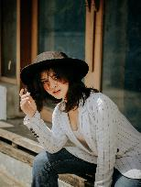

HOME
ABOUT
DESIGND BY MUYUESHOP
TEMPALTE DESIGEND
I walked through many mountains, walked through many waters, and knew many people. The only thing that really makes me tempted is that you see me at the moment. But there is not too much extravagant hope, but I hope to have your heart, not to leave.
COLLECTION

Slide 4

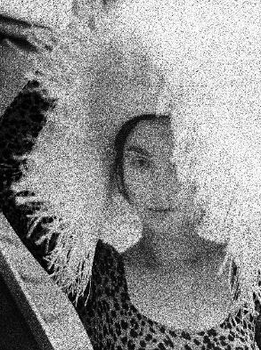
HOME
ABOUT
DESIGND BY MUYUESHOP
TEMPALTE DESIGEND
I walked through many mountains, walked through many waters, and knew many people. The only thing that really makes me tempted is that you see me at the moment. But there is not too much extravagant hope, but I hope to have your heart, not to leave.
COLLECTION

Slide 5
YOUR TITLE TEXT HERE
I walked through many mountains, walked through many waters, and knew many people. The only thing that really makes me tempted is that you see me at the moment. But there is not too much extravagant hope, but I hope to have your heart, not to leave.
TEMPALTE DESIGEND
I walked through many mountains, walked through many waters, and knew many people. The only thing that really makes me tempted is that you see me at the moment. But there is not too much extravagant hope, but I hope to have your heart, not to leave.
I walked through many mountains, walked through many waters, and knew many people. The only thing that really makes me tempted is that you see me at the moment. But there is not too much extravagant hope, but I hope to have your heart, not to leave.
YOUR TITLE TEXT HERE
I walked through many mountains, walked through many waters, and knew many people. The only thing that really makes me tempted is that you see me at the moment.
YOUR TITLE TEXT HERE
I walked through many mountains, walked through many waters, and knew many people. The only thing that really makes me tempted is that you see me at the moment.

Slide 6

HOME
ABOUT
DESIGND BY MUYUESHOP
I walked through many mountains, walked through many waters, and knew many people.
I walked through many mountains, walked through many waters, and knew many people. The only thing that really makes me tempted is that you see me at the moment. But there is not too much extravagant hope, but I hope to have your heart, not to leave.
TEMPALTE DESIGEND
I walked through many mountains, walked through many waters, and knew many people. The only thing that really makes me tempted is that you see me at the moment. But there is not too much extravagant hope, but I hope to have your heart, not to leave.
I walked through many mountains, walked through many waters, and knew many people. The only thing that really makes me tempted is that you see me at the moment. But there is not too much extravagant hope, but I hope to have your heart, not to leave.
COLLECTION

Slide 7
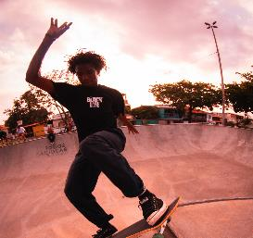
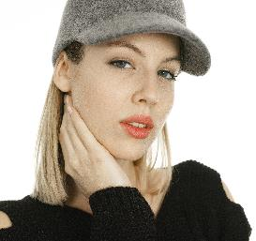
HOME
ABOUT
DESIGND BY MUYUESHOP
TEMPALTE DESIGEND
I walked through many mountains, walked through many waters, and knew many people. The only thing that really makes me tempted is that you see me at the moment. But there is not too much extravagant hope, but I hope to have your heart, not to leave.
COLLECTION

Slide 8
HOME
ABOUT
DESIGND BY MUYUESHOP
TEMPALTE DESIGEND
I walked through many mountains, walked through many waters, and knew many people. The only thing that really makes me tempted is that you see me at the moment. But there is not too much extravagant hope, but I hope to have your heart, not to leave.
I walked through many mountains, walked through many waters, and knew many people. The only thing that really makes me tempted is that you see me at the moment
I walked through many mountains, walked through many waters, and knew many people..
单击此处输入标题
单击此处输入标题
单击此处输入标题
I walked through many mountains, walked through many waters, and knew many people. The only thing that really makes me tempted is that you see me at the moment
I walked through many mountains, walked through many waters, and knew many people. The only thing that really makes me tempted is that you see me at the moment
I walked through many mountains, walked through many waters, and knew many people. The only thing that really makes me tempted is that you see me at the moment
COLLECTION

Slide 9

HOME
ABOUT
DESIGND BY MUYUESHOP
TEMPALTE DESIGEND
I walked through many mountains, walked through many waters, and knew many people. The only thing that really makes me tempted is that you see me at the moment. But there is not too much extravagant hope, but I hope to have your heart, not to leave.
单击此处输入标题
单击此处输入标题
I walked through many mountains, walked through many waters, and knew many people. The only thing that really makes me tempted is that you see me at the moment
I walked through many mountains, walked through many waters, and knew many people. The only thing that really makes me tempted is that you see me at the moment
COLLECTION

Slide 10
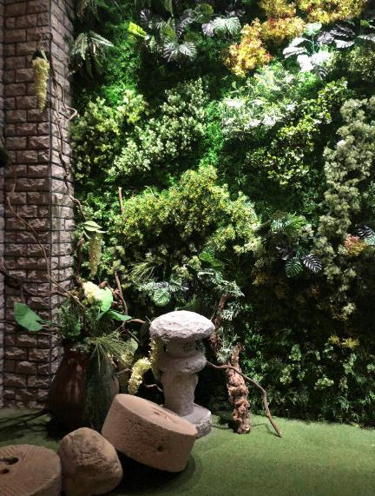
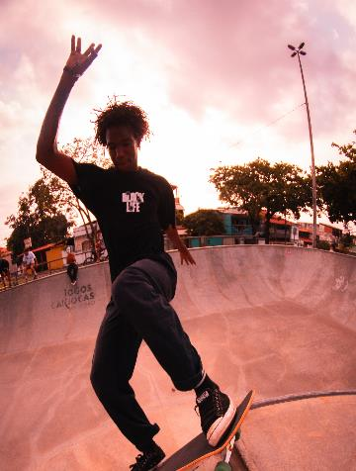
HOME
ABOUT
DESIGND BY MUYUESHOP
tempalte
I walked through many mountains, walked through many waters, and knew many people. The only thing that really makes me tempted is that you see me at the moment. But there is not too much extravagant hope, but I hope to have your heart, not to leave.
COLLECTION

Slide 11
TEMPALTE DESIGEND
单击此处输入标题
I walked through many mountains, walked through many waters, and knew many people. The only thing that really makes me tempted is that you see me at the moment
I walked through many mountains, walked through many waters, and knew many people. The only thing that really makes me tempted is that you see me at the moment. But there is not too much extravagant hope, but I hope to have your heart, not to leave.
I walked through many mountains, walked through many waters, and knew many people. The only thing that really makes me tempted is that you see me at the moment. But there is not too much extravagant hope, but I hope to have your heart, not to leave.
单击此处输入标题
I walked through many mountains, walked through many waters, and knew many people. The only thing that really makes me tempted is that you see me at the moment

Slide 12




HOME
ABOUT
DESIGND BY MUYUESHOP
TEMPALTE DESIGEND
I walked through many mountains, walked through many waters, and knew many people. The only thing that really makes me tempted is that you see me at the moment. But there is not too much extravagant hope, but I hope to have your heart, not to leave.
I walked through many mountains, walked through many waters, and knew many people. The only thing that really makes me tempted is that you see me at the moment. But there is not too much extravagant hope, but I hope to have your heart, not to leave.
COLLECTION

Slide 13
HOME
ABOUT
DESIGND BY MUYUESHOP
TEMPALTE DESIGEND
I walked through many mountains, walked through many waters, and knew many people. The only thing that really makes me tempted is that you see me at the moment. But there is not too much extravagant hope, but I hope to have your heart, not to leave. I walked through many mountains, walked through many waters, and knew many people. The only thing that really makes me tempted is that you see me at the moment. But there is not too much extravagant hope, but I hope to have your heart, not to leave.
I walked through many mountains, walked through many waters, and knew many people. The only thing that really makes me tempted is that you see me at the moment. But there is not too much extravagant hope, but I hope to have your heart, not to leave.
单击此处输入标题
单击此处输入标题
I walked through many mountains, walked through many waters, and knew many people. The only thing that really makes me tempted is that you see me at the moment
I walked through many mountains, walked through many waters, and knew many people. The only thing that really makes me tempted is that you see me at the moment
COLLECTION

Slide 14

HOME
ABOUT
DESIGND BY MUYUESHOP
TEMPALTE DESIGEND
I walked through many mountains, walked through many waters, and knew many people. The only thing that really makes me tempted is that you see me at the moment. But there is not too much extravagant hope, but I hope to have your heart, not to leave.
I walked through many mountains, walked through many waters, and knew many people. The only thing that really makes me tempted is that you see me at
COLLECTION

Slide 15
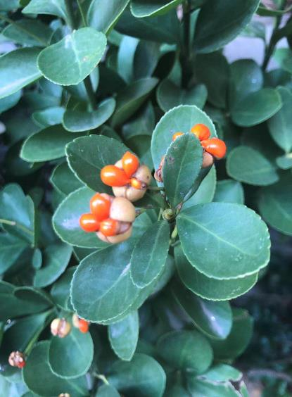
DESIGND BY MUYUESHOP
Shade Beauty.
添加此处原有标题
I walked through many mountains, walked through many waters, and knew many people. The only thing that really makes me tempted is that you see me at the moment.
I WALKED THROUGH MANY MOUNTAINS, WALKED THROUGH MANY WATERS, AND KNEW MANY PEOPLE. THE ONLY THING THAT REALLY MAKES ME TEMPTED IS THAT YOU SEE ME AT THE MOMENT
I walked through many mountains, walked through many waters, and knew many people. The only thing that really makes me tempted is that you see me at the moment.
I walked through many mountains, walked through many waters, and knew many people. The only thing that really makes me tempted is that you see me at the moment.
添加此处原有标题
I walked through many mountains, walked through many waters, and knew many people. The only thing that really makes me tempted is that you see me at the moment.

Slide 16
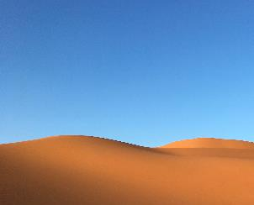
DESIGND BY MUYUESHOP
Shade Beauty.
I walked through many mountains, walked through many waters, and knew many people. The only thing that really makes me tempted is that you see me at the moment.
I walked through many mountains, walked through many waters, and knew many people. The only thing that really makes me tempted is that you see me at the moment.

Slide 17

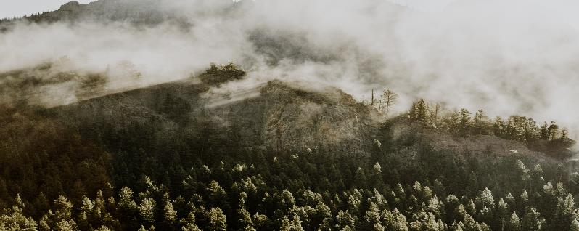
OUR SERVICE SLIDE.
Shade Beauty.
I walked through many mountains, walked through many waters, and knew many people. The only thing that really makes me tempted is that you see me at the moment.

Slide 18
01
walked through many mountains, walked through many waters
DESIGND BY MUYUESHOP
PRODUCT #1
Shade Beauty.
walked through many mountains, walked through many waters
02
PRODUCT #2
I walked through many mountains, walked through many waters, and knew many people. The only thing that really makes me tempted is that you see me at the moment. I walked through many mountains, walked through many waters, and knew many people. The only thing that really makes me tempted is that you see me at the moment.
03
walked through many mountains, walked through many waters
PRODUCT #3

Slide 19
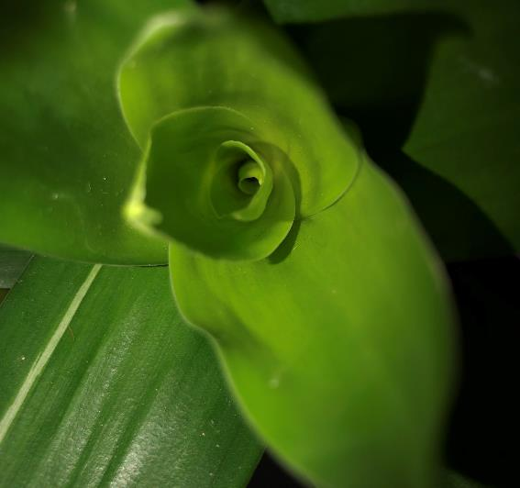

DESIGND BY MUYUESHOP
Shade Beauty.
I walked through many mountains, walked through many waters, and knew many people. The only thing that really makes me tempted is that you see me at the moment.
I walked through many mountains, walked through many waters, and knew many people. The only thing that really makes me tempted is that you see me at the moment.
I walked through many mountains, walked through many waters, and knew many people.

Slide 20
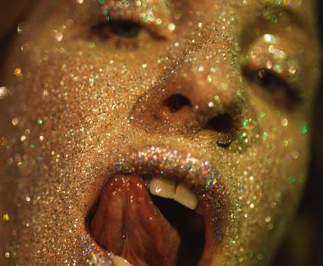
01
I walked through many mountains, walked through many waters, and knew many people
DESIGND BY MUYUESHOP
Shade Beauty.
02
I walked through many mountains, walked through many waters, and knew many people
03
I walked through many mountains, walked through many waters, and knew many people
添加此处原有标题
I walked through many mountains, walked through many waters, and knew many people. The only thing that really makes me tempted is that you see me at the moment. But there is not too much extravagant hope, but I hope to have your heart, not to leave.

Slide 21
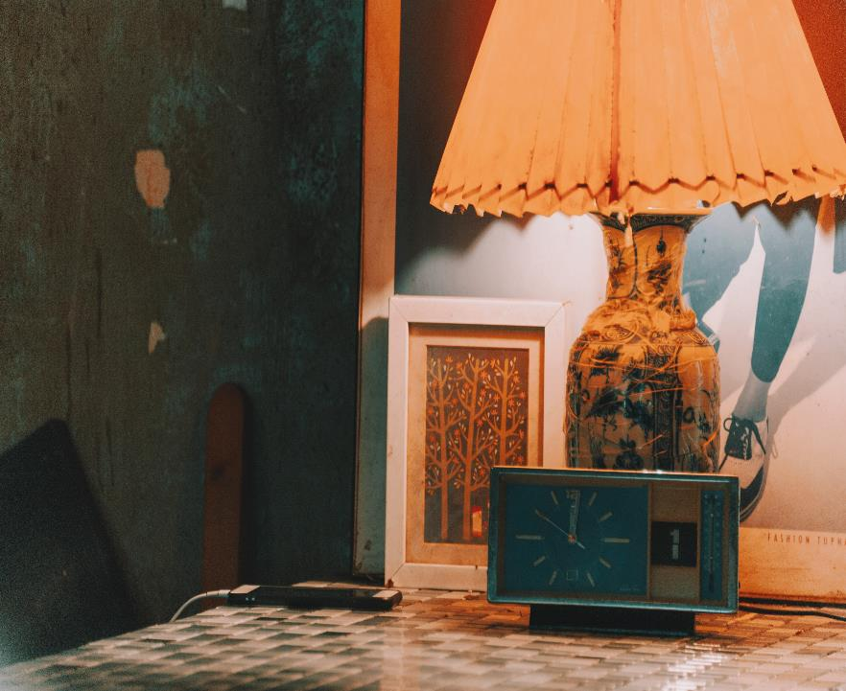
DESIGND BY MUYUESHOP
添加此处原有标题
Shade Beauty.
I walked through many mountains, walked through many waters, and knew many people. The only thing that really makes me tempted is that you see me at the moment. But there is not too much extravagant hope, but I hope to have your heart, not to leave.
添加此处原有标题
I walked through many mountains, walked through many waters, and knew many people. The only thing that really makes me tempted is that you see me at the moment. But there is not too much extravagant hope, but I hope to have your heart, not to leave.

Slide 22

W
I WALKED THROUGH MANY MOUNTAINS
I walked through many mountains, walked through many waters, and knew many people. The only thing that really makes me tempted is that you see me at the moment. I walked through many mountains, walked through many waters, and knew many people. The only thing that really makes me tempted is that you see me at the moment.

Slide 23
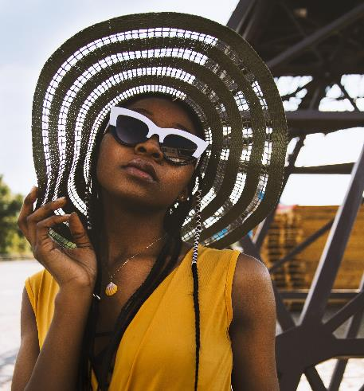
I WALKED THROUGH MANY MOUNTAINS
I walked through many mountains, walked through many waters, and knew many people. The only thing that really makes me tempted is that you see me at the moment. I walked through many mountains, walked through many waters, and knew many people. The only thing that really makes me tempted is that you see me at the moment.

Slide 24
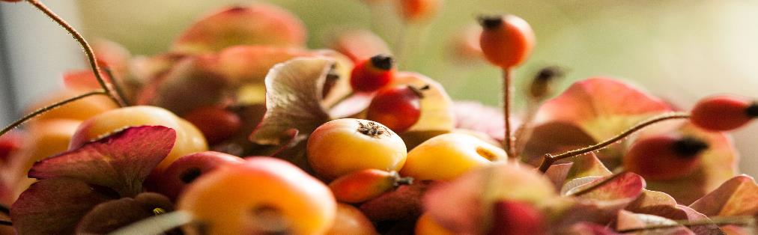
TEXT HERE
添加此处原有标题
I walked through many mountains, walked through many waters, and knew many people. The only thing that really makes me tempted is that you see me at the moment. But there is not too much extravagant hope, but I hope to have your heart, not to leave.
I walked through many mountains, walked through many waters, and knew many people. The only thing that really makes me tempted is that you see me at the moment. But there is not too much extravagant hope, but I hope to have your heart, not to leave.
DESIGND BY MUYUESHOP
Shade Beauty.

Slide 25

添加此处原有标题
I walked through many mountains, walked through many waters, and knew many people. The only thing that really makes me tempted is that you see me at the moment.
添加此处原有标题
I walked through many mountains, walked through many waters, and knew many people.
添加此处原有标题
添加此处原有标题
I walked through many mountains, walked through many waters, and knew many people. The only thing that really makes me tempted is that you see me at the moment.
I walked through many mountains, walked through many waters, and knew many people.
添加此处原有标题
I walked through many mountains, walked through many waters, and knew many people.
添加此处原有标题
I walked through many mountains, walked through many waters, and knew many people. The only thing that really makes me tempted is that you see me at the moment.

Slide 26

HOME
ABOUT
DESIGND BY MUYUESHOP
THANKA FOR
WATCHING
精致的旧时光
I walked through many mountains, walked through many waters, and knew many people. The only thing that really makes me tempted is that you see me at the moment. But there is not too much extravagant hope, but I hope to have your heart, not to leave.
COLLECTION

